Slide 1
Data-Driven Optimization and Fault Detection in Solar Power Plants
CIVE70111 - Machine Learning
Group 11
12/12/2025

Slide 2
Scope and Objectives
Power Forecasting
1. Predict DC Power output for the next period.
2.Helps plan energy dispatch
Raw Data
What is the problem? Why do we need to solve it? How to solve it?
Challenge
Solar energy is intermittent and weather-dependent, making it hard for grid operators to balance supply and demand.
Solution
Accurate forecasting to ensure grid stability and fault detection to minimize downtime.
Propressing
Data Mining Pipeline
1. Data Cleaning
2. Feature Engineering
3. Model Training
4. Evaluation.
Regression
Fault Detection
1. Identify inverters that are underperforming
2. Enables predictive maintenance and reduces loss
Classification
Task
Performance
Experience
Insights

Slide 3
Scope and Objectives
Task
Performance
Experience

Slide 4
Task 3
Objective
Conduct an exploratory analysis of the power generation and sensor data, derive insights to inform modelling decisions, and prepare for machine learning.
Workflow Overview
Data Ingestion
Loaded raw CSV files
Fix timestamp formats, remove invalid rows utlier Detection
Clean Data & Outlier Detection
Check for missing values and duplicates
Remove high‑residual (z > 3) points
Aggregate & Merge
Combine inverter readings with weather by timestamp
Links specific power output to the exact weather conditions
EDA & Visualization
Calculated Correlation Matrices and visualized Time-Series Plots.
Visualized the "Bell Curve" of daily production

Slide 5
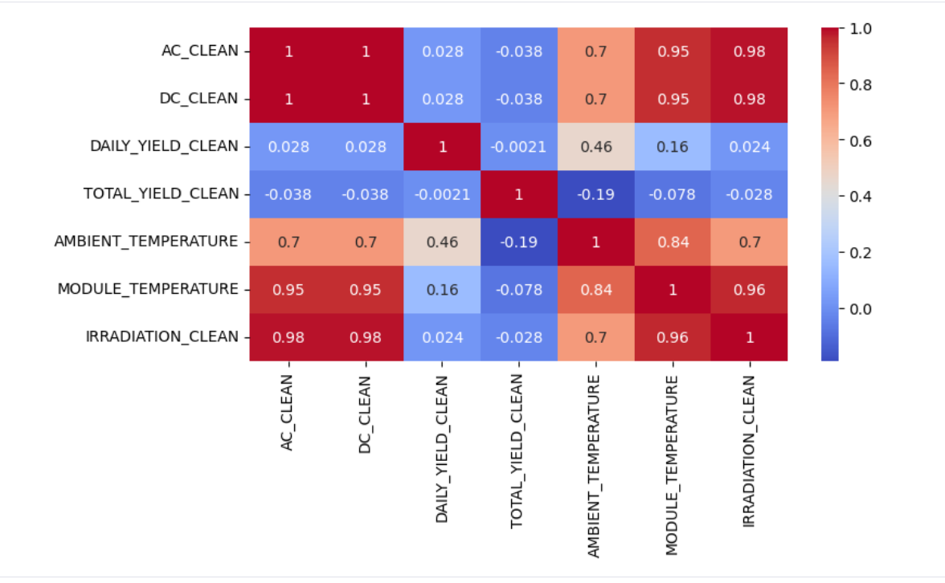
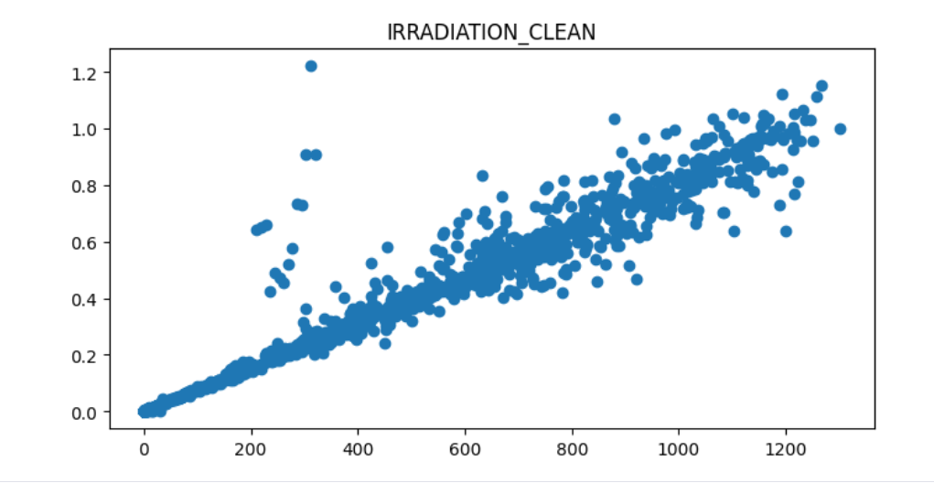
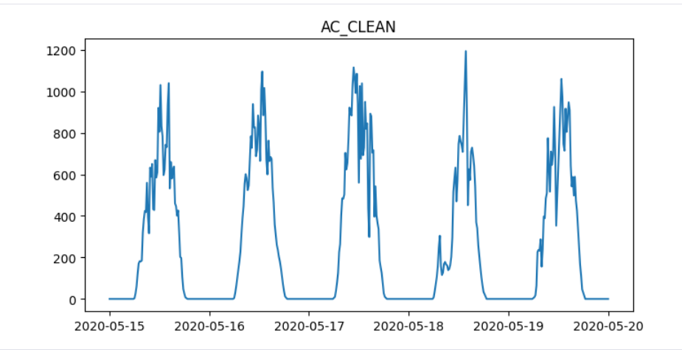
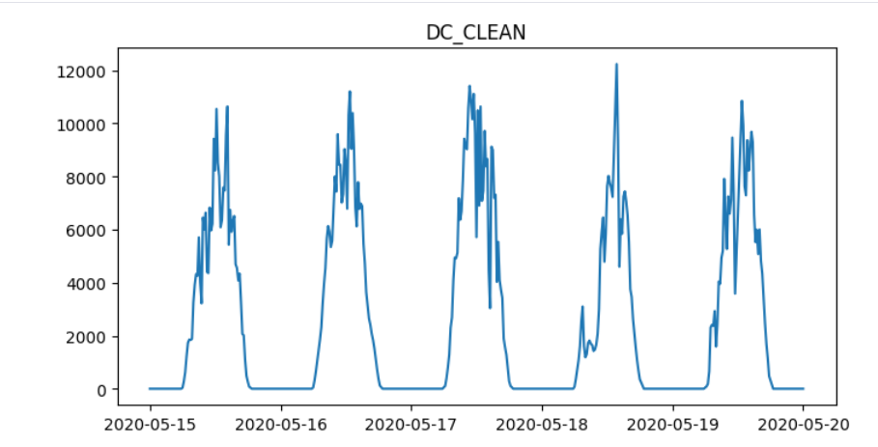
Task 2 Results
Key insights from Data
Irradiation is the main driver.
Correlation Matrix confirms a positive correlation (0.98) between Irradiation and DC Power.
Module_Temperature is the secondary factor
Shows a strong correlation with power (0.95), higher than Ambient_Temperature, indicating that the panel's internal temperature is a more relevant feature than the surrounding air temperature.
3. Linearity
The data points form a tight, linear cluster extending from the origin, confirming the strong physical relationship identified in the heatmap
4. Daily cyclical pattern
Shows a daily cyclical pattern in power generation.This observation justifies the feature engineering step where
we extracted the 'Hour' component from the timestamp
Key Predictors Correlation Heatmap
Scatter Plot: Irradiation vs. DC Power
Temporal Dynamics: Verification of Daily Solar Cycles

Slide 6
Introduction to Task 3
Objectives
Develop models to forecast the power output using environmental conditions to anticipate power production capabilities and optimize.
Workflow Overview
Feature Selection & Data Splitting
Selected Irradiation, Ambient Temperature, Module Temperature as predictors.
Split each inverter into one CSV per day
Modeling Training
Linear Regression
Neural Network
Lasso Regression
Ridge Regression
Random Forest
Performance Evaluation
Calculated RMSE, MAE and R² for DC & AC power.
Compare model Bias–variance, performance & stability
Neural Network Analysis and Operational Visualisation
Visualise DC & AC loss curves
Compute convergence speed, iterations, training time
Time‑of‑day performance plots

Slide 7
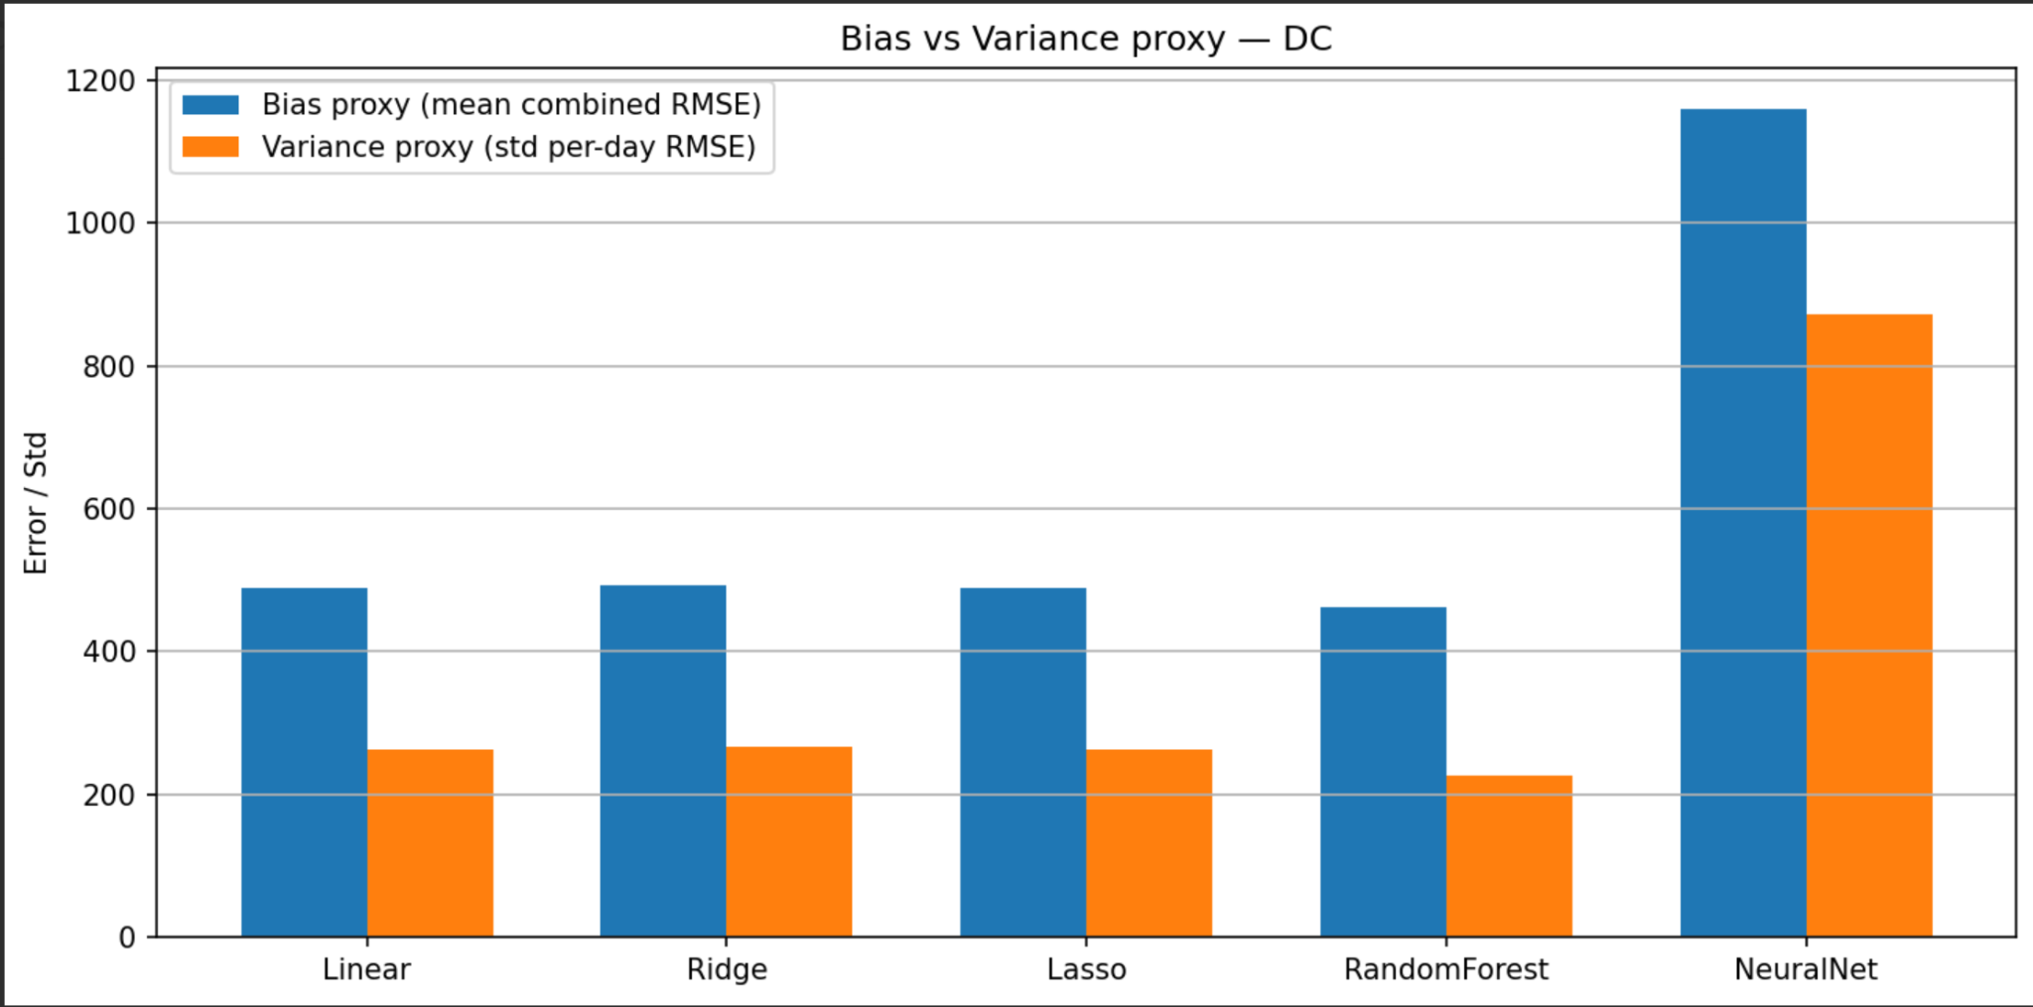
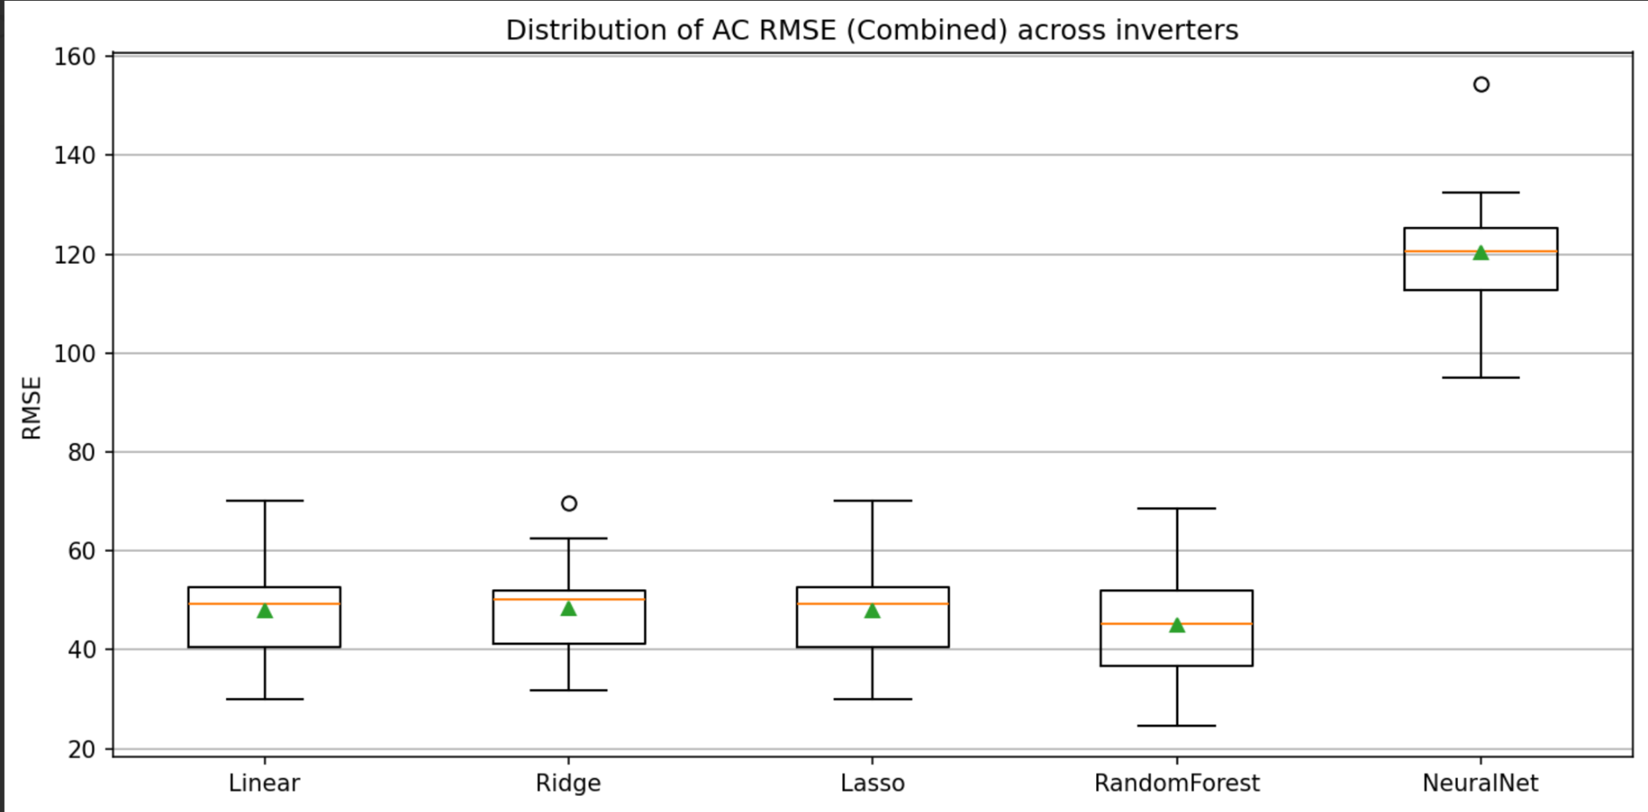
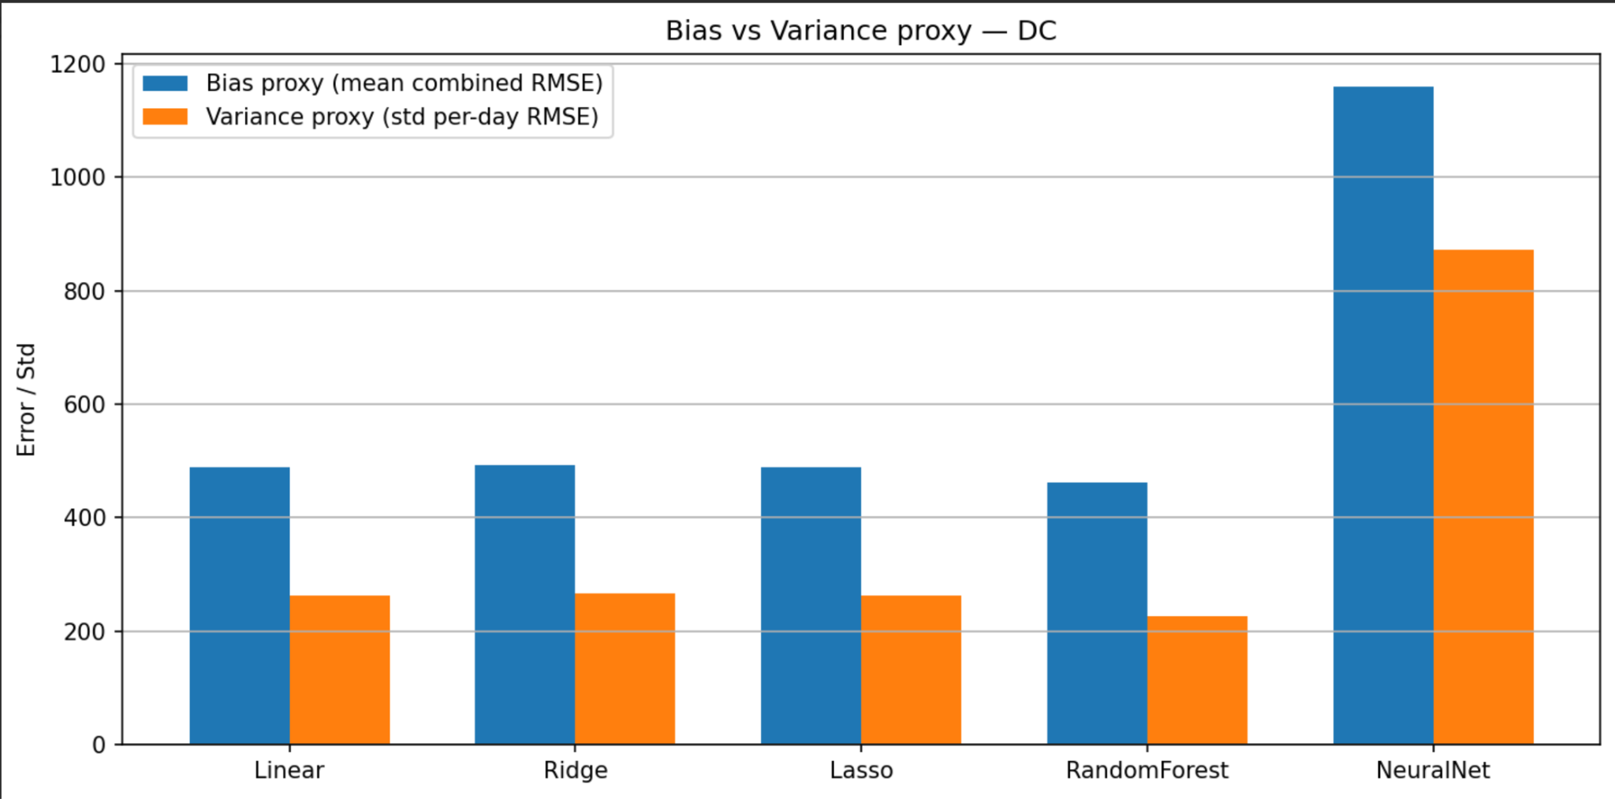
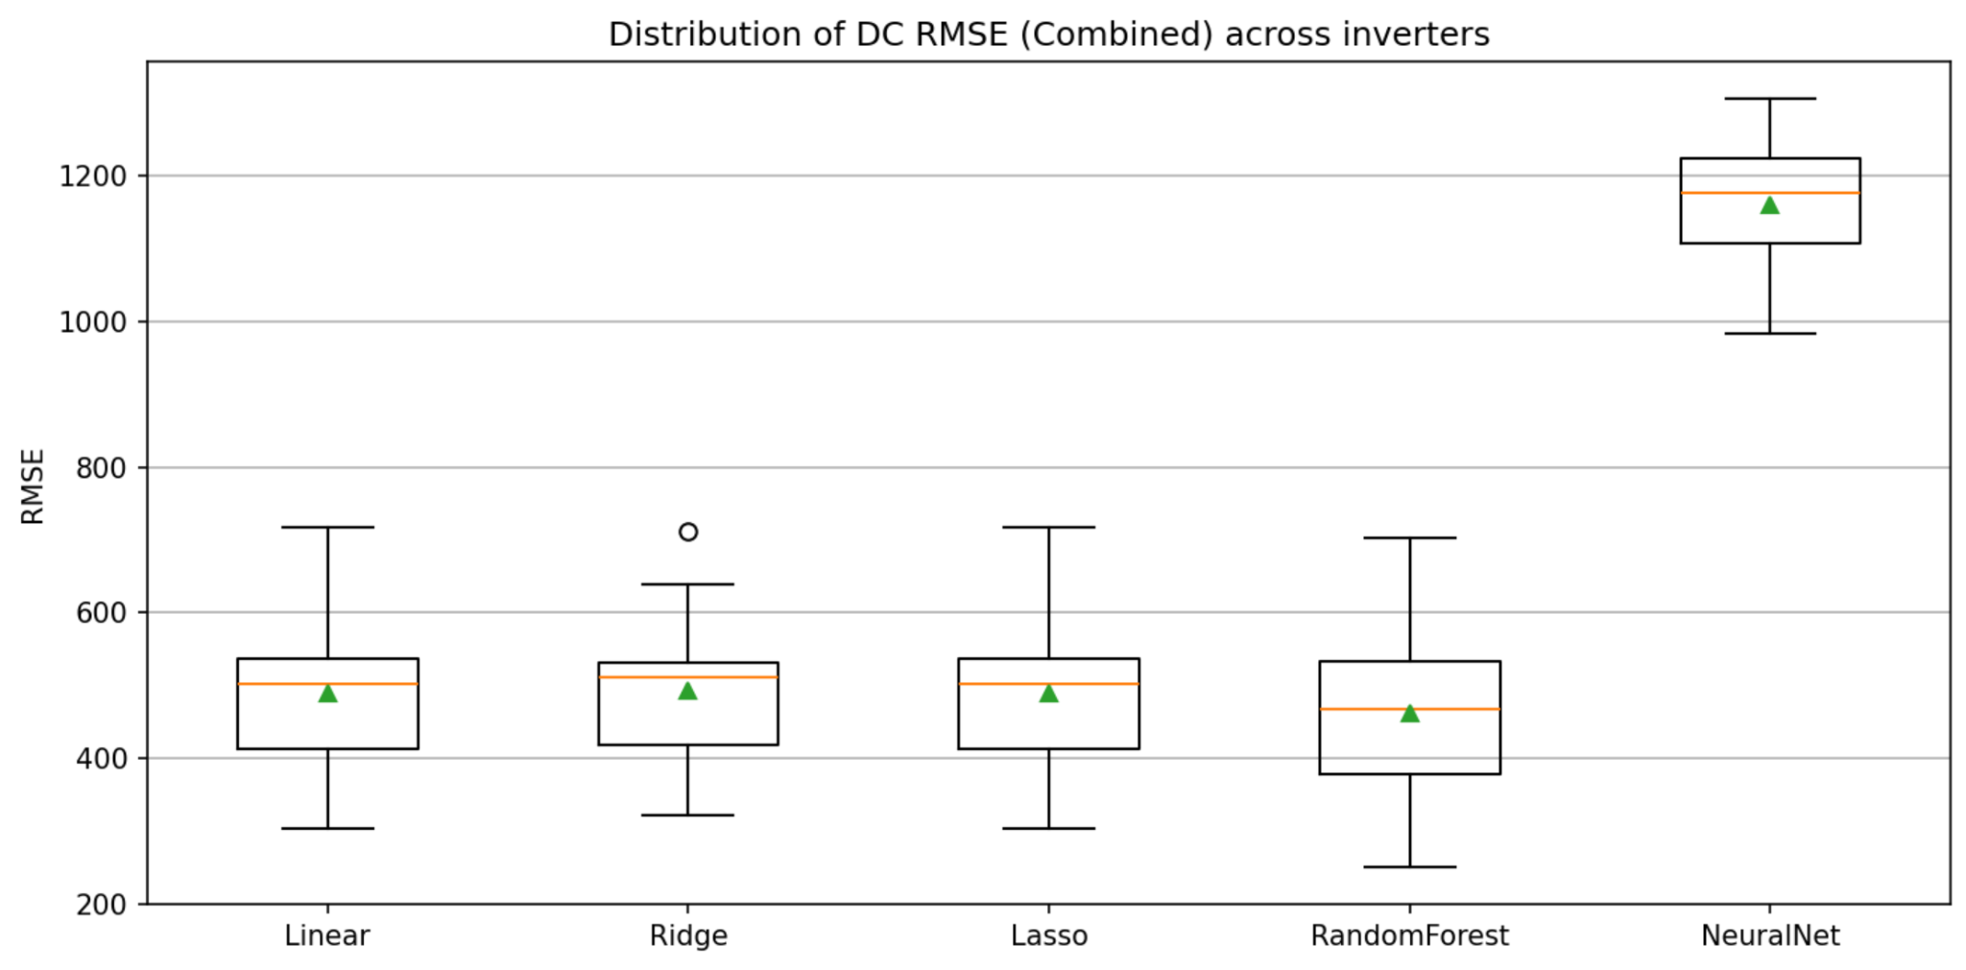
Task 3 Results
Performance & Insights
Five different models been trained for comparison.
Deviation & Variance
 | Random Forest shows the smallest value
 | Random Forest has the best accuracy and stability
RMSE in all inverters
 | Random Forest shows the narrowest distribution
 | Random Forest model performs consistently well across different hardware
Bias-Variance Analysis using RMSE Proxies
Distribution of RMSE across 22 Inverters

Slide 8
Introduction to Task 4
Objective
Detect suboptimal inverter operating conditions in solar plants using interpretable, data‑driven machine learning models.
Workflow Overview
Key Takeaway
Data Loading & Cleaning
Import inverter + weather data (Plant 1 & 2).
Fix timestamps, clean AC/DC power, yields, and irradiation.
Remove outliers via regression residual analysis.
Feature Scaling improves all models.
Feature Selection (Drop‑Column) enhances stability & interpretability.
Outlier Removal did not improve performance — some were valid points.
Feature Engineering
Compute ratios: AC/IRRA, DC/IRRA.
Add temperature + yield features.
Label target: Optimal (0) / Suboptimal (1).
Time‑Based Splitting
Chronological train /
validation / test split
→ prevent leakage.
Model Training
Models: Logistic Regression & Linear SVC
(with & without scaling).
Balanced class weights; F1‑optimised thresholds for suboptimal detection.
Interpretability
ALE plots → feature impact direction.
Drop‑Column Importance → quantify feature contribution.
Experiments
With / without outlier removal.
Before / after feature selection.
Compare Plant 1 vs Plant 2.

Slide 9
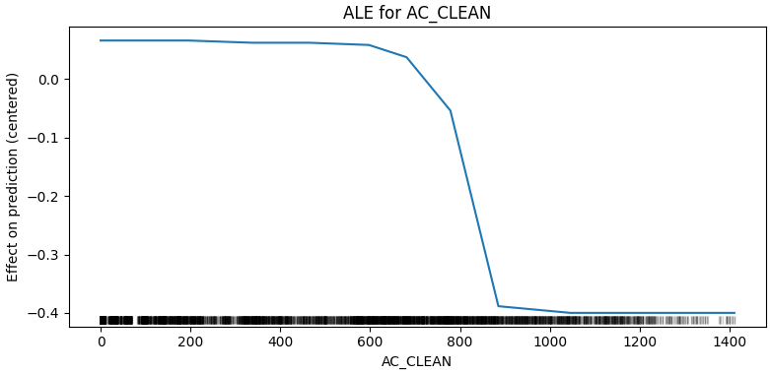
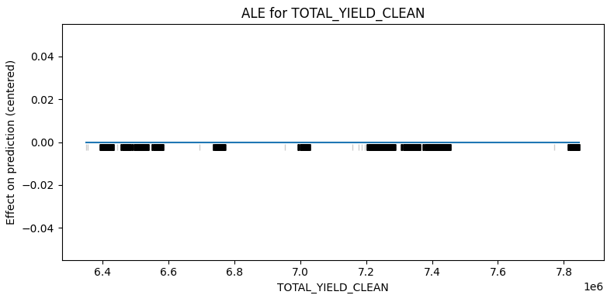
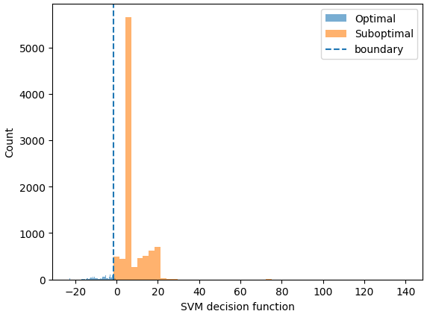
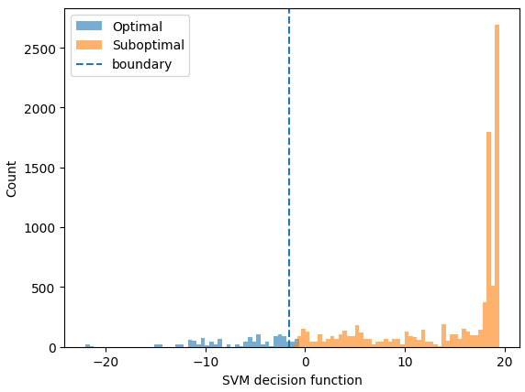

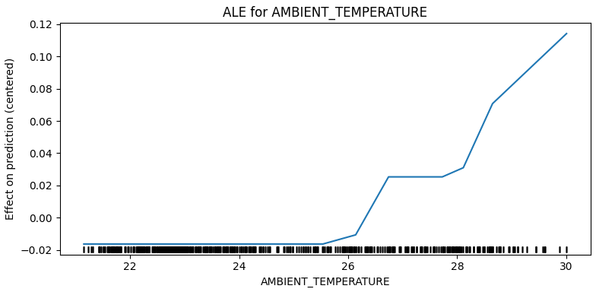
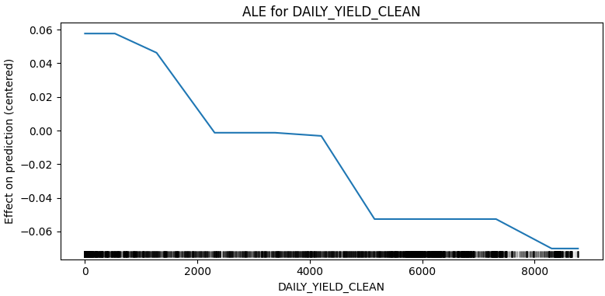
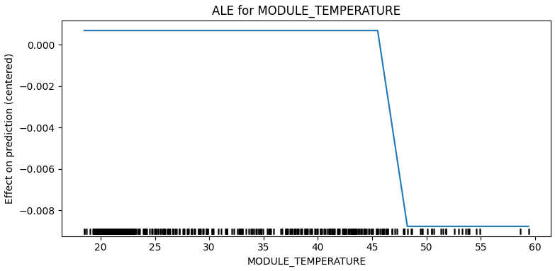
Task 4 Results
Experiments : Plant 1
Before feature selection vs After feature selection
With outliers vs Without outliers
Condition | Outliers | Feature Selection | Accuracy | Macro F1 | Analysis
1. Before feature selection | ✅ Included | ❌ No | 0.989–0.990 | ≈ 0.974–0.975 | Excellent results; model predicts both classes well
2. After feature selection | ✅ Included | ✅ Yes | 0.990 | ≈ 0.975 | Almost identical to before; feature removal did not affect much
3. Before feature selection | ❌ Removed | ❌ No | 0.991–0.992 | ≈ 0.975–0.979 | Still very high, but recall slightly improved due to data cleaning
4. After feature selection | ❌ Removed | ✅ Yes | 0.989–0.991 | ≈ 0.971–0.975 | Small drop — less diverse data and fewer features slightly reduced precision
ALE plots for feature selection
SVM decision function

Slide 10
Introduction to Task 5
Objective
Interpret Random Forest models for DC and AC power prediction.
Identify key features influencing PV output (irradiation, temperature, time‑of‑day).
Compare Plant 1 vs Plant 2 and extract physical/operational insights.
Workflow Overview
Data Loading & Cleaning | Combine inverter CSVs, filter dates, fill gaps.
Feature Engineering | Create irradiation, temperature, yield, and time‑of‑day features.
Key Takeaway
Train Models | Random Forest regressors for DC and AC outputs.
Permutation Importance – used to catch few important features.
SHAP – feature‑level contribution to predictions.
PDP – global relationship between features and output.
Interpret Models using | Permutation Importance (global ranking) SHAP Waterfall Plots (local effects) Residualisation Coefficients (feature sensitivity) PDP & PDP Slopes (average feature influence)
Output | Visualize & Compare results for both

Slide 11
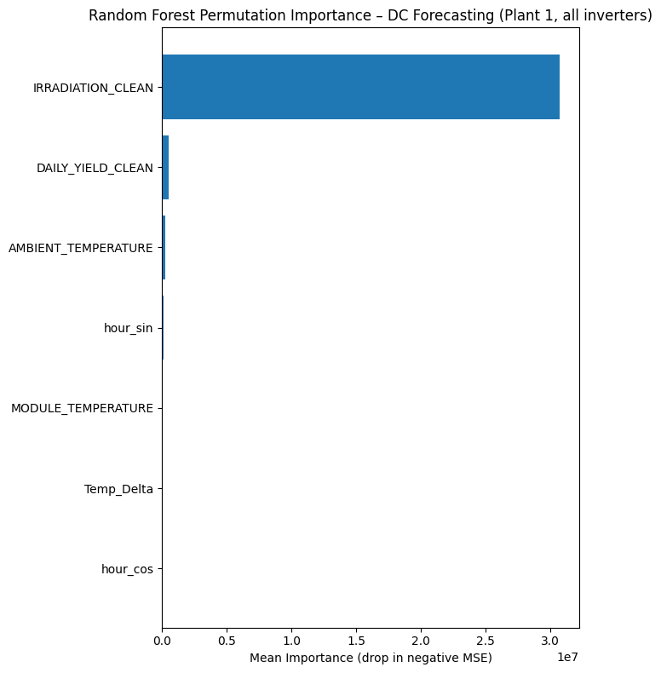
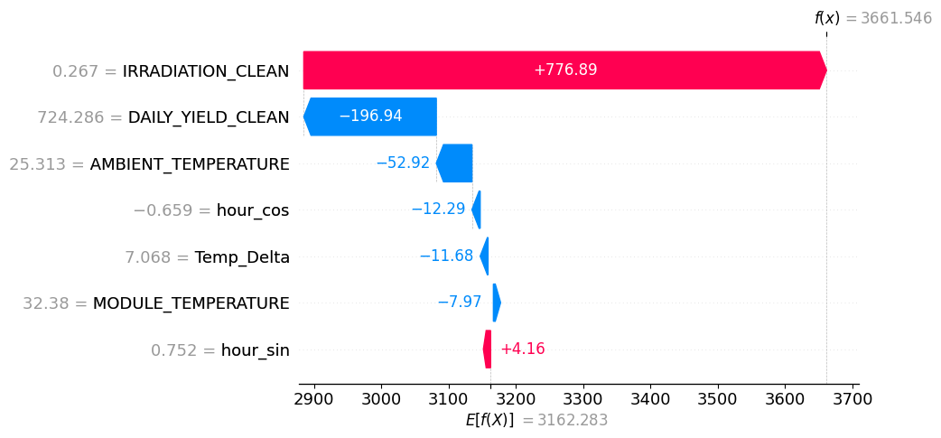
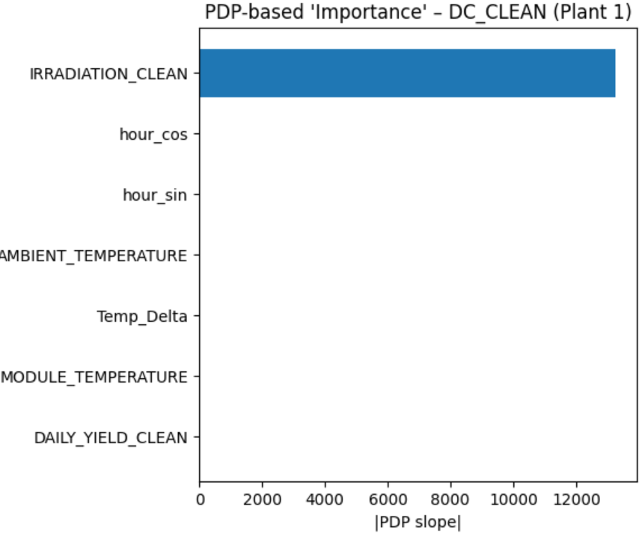
Task 5 Results
Permutation Importance
the feature of model strongly depends on.
SHAP Waterfall Plot
higher sunlight drastically raises AC power.
PDP-Based Importance
strongest effect on output. ( uses as coefficient)

Slide 12
Introduction to Task 6
Objective
Analyze and model two PV plants to:
Classify operation as Optimal/Suboptimal (Linear SVC).
Forecast AC/DC power 1 hour ahead (PyTorch LSTM).
Workflow Overview
Loading Data:
Data Cleaning & Validation
Feature Engineering
Forecasting (LSTM)
Load CSV files for each plant
Merge data on timestamp and source key (inverter ID)
Convert timestamps to a uniform timezone (15‑min interval assumed)
Timestamp cleaning
Irradiance correction
Remove negatives/outliers
Replace missing data with interpolation (time‑based).
Fix cumulative yields
For each inverter, generate clean sub‑DataFrames.
Compute power‑to‑irradiance ratios
Compute temperature difference
Extract time features
Normalize column naming with suffix
Create sequences:
Train/validation/test split
chronologically.
Normalize features:
Model design
Training
Evaluate
Key Takeaway
Built an end‑to‑end ML pipeline for PV plants.
Linear SVC → classifies Optimal vs Suboptimal operation.
LSTM → forecasts AC/DC power 1 hour ahead.

Slide 13
Task 6 Results
Classification (Linear SVC)
Plant | Optimal | Suboptimal | Threshold | PR‑AUC | Accuracy | F1 (Suboptimal) | Remarks
Plant 1 | 7 656 | 38 024 | 0.0065 | 1.0000 | 99.0 % | 0.994 | Excellent separation; almost perfect recall (1.0)
Plant 2 | 7 414 | 60 284 | 0.7671 | 0.9987 | 96.0 % | 0.978 | Very high precision/recall; mild false positives
The LSTM consistently beats baseline models, yielding lower MAE & RMSE, meaning more accurate 1‑hour ahead power forecasts.
Key Takeaway
Both plants show exceptional classifier performance, reliably identifying suboptimal operation with nearly perfect PR‑AUC and F1 scores.
LSTM has higher accuracy than other baseline models
2. Forecasting (LSTM vs Baselines)
Plant | LSTM_MAE | LSTM_RMSE | Persistence_MAE | Persistence_RMSE | MA_MAE | MA_RMSE | Winner
Plant 1 (AC) | 86.9 | 135 | 96.6 | 171 | 117.9 | 189 | LSTM (by ~10 MAE ↓)
Plant 2 (AC) | 888.7 | 1 390 | 988.4 | 1 755 | 1 207 | 1 935 | LSTM (by ~10 % better)
Plant 1 (DC) | 97.0 | 146 | 98.2 | 169 | 106.3 | 171 | LSTM slightly better
Plant 2 (DC) | 94.6 | 147 | 100.4 | 172 | 108.7 | 175 | LSTM superior

Slide 14
DashBoard
Showcasing now

Slide 15
Thank you
CIVE70111 - Machine Learning
Group 11
12/12/2025

